Slide 1

Cardano India Upskilling Program

Slide 2
Contents
1. Who we are?
2. What do we aim for?
3. What did we offer in the upskilling program?
4. Our Journey
5. Projects

Slide 3
Who we are?
Cardano India Developers Community (CIDC) is being a part of the Cardano community for the last 2 years.
CIDC is committed to identifying experienced web 2.0 developers, bringing awareness, training them on Plutus and Atala Prism, and ultimately adding them to Cardano Ecosystem by assisting them to get projects.
CIDC is a premier IT Development, consulting, and Training company started by passionate individuals who have more than 20+ years of industry experience in Service Management, Project management & high end value added frameworks.

Slide 4
What do we aim for?
The Indian IT Industry employs 4 Million workers with nearly half being software developers yet of the 2 million developers in India, regularly 5000 or a quarter of one percent (0.25%) possess the necessary blockchain development skills. On the other hand, Cardano is having its own problems related to a serious shortage of qualified senior developers, as it is in Plutus or Atala Prism.
At CIDC we bring a distinct approach to advisory and investment management that challenges the start quo.

Slide 5
What did we offer in upskilling program?
In our upskilling program, we offered 4 months of training on Haskell and Plutus each for 2 months. One-month live project participation for performed personals.
As part of Haskell, we covered Haskell installation, Basic Haskell Programming, Functions, Recursion, Condition Statement, Input/Output, and Map Concepts, Pragmas, Modules, Modifiers, Head, Tail, and Reverse features, Functor, Applicative Functor, Monoid, Monads
As part of Plutus, Off-Chain & On-Chain, Cardano Plutus with Playground, NIX OS Installation, Eternal and Nami Wallet extension installation, Create a Dapp using Mesh, Marlow, Dapps with Demeter, Plutus Cardano Preview Node installation, Mesh Js NFT Market place & Lucid.

Slide 6
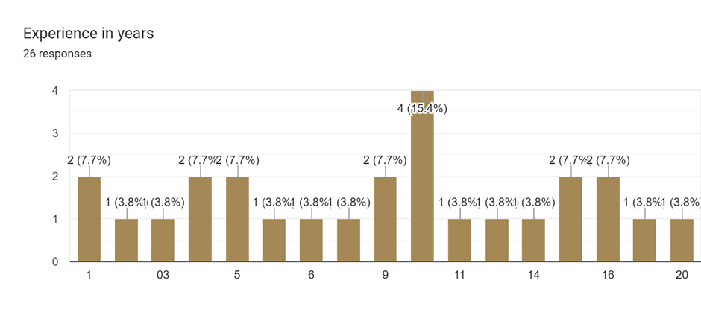
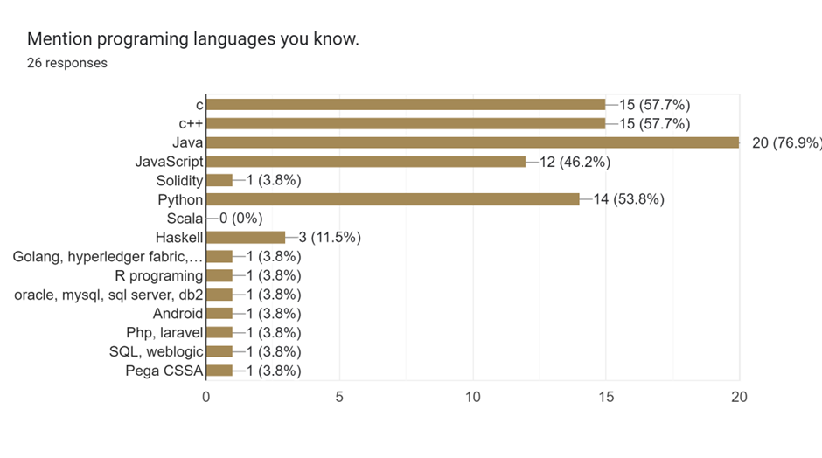
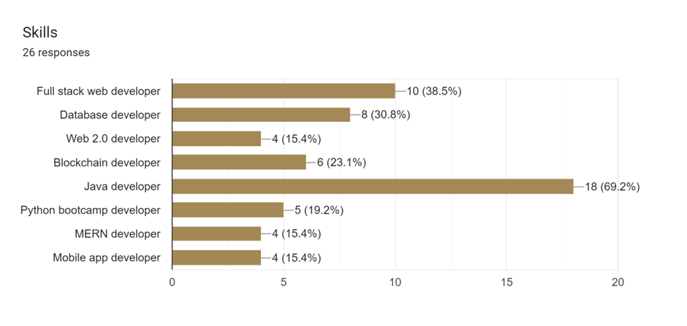
Our Journey
In this upskilling program, we have successfully added almost 30 experienced personnel, with various IT experiences in different technologies into our Community.

Slide 7
Our Journey
After the initial promotions, we started our sessions with the developers on 15th Nov. 2022. In this upskilling program, we do follow IOHK course patterns. Every week there are two sessions where we are connecting with the members for 1 hr-1.30 hr, to guide and problem-solve.
In our 1st session, we do share the course content and technicality of the course. In the 2nd session, we checked their progress and solved their doubts and problems.
We are continuously sharing content to bring awareness among more developers about Cardano with the help of social networks like LinkedIn, Facebook, Twitter, and Instagram.
Linkedin: https://www.linkedin.com/in/cardano-india-developers-community-764800252
Facebook: https://www.facebook.com/profile.php?id=100086149197444
Twitter: https://twitter.com/CardanoIndia
Instagram: https://www.instagram.com/indiacardano/

Slide 8
Our Journey
We are using GitHub, Discord, and Youtube platform to share the technical solution with our participants. All our sessions have been recorded for future reference and shared in our YouTube handler. For the above chapters, we have discussed more than 100 programs and homework which have been uploaded to GitHub week-wise.
GitHub repo: https://github.com/CardanoIndiaDevelopersCommunity/
Upskill Program Youtube Handle: https://www.youtube.com/@cardanoindia
Discord: https://discord.gg/CjvnXGYh
Website: https://www.cardanoindia.org/
Email id: cardanoindia@gmail.com

Slide 9
Projects
Project- Cloud1O LMS:
Cloud10 LMS (Loyalty Management System) is a platform that helps businesses to integrate, implement and manage their loyalty programs. It provides a centralized platform for tracking customer interactions, managing rewards and incentives, and analyzing customer behaviour and preferences. The system is designed as a pluggable module for Channels or Booking Engines of the hospitality domain.
Welcome to Cloud10 Loyalty Management System, a comprehensive platform designed to help you build lasting relationships with your customers through personalized rewards and experiences.
The system is equipped with four key modules: Integration, Users, Manager, Admin, AI, and Recommendation. Each module is dealing with its own unique features and benefits.
GitHub Link : https://github.com/Cloud10-Loyality/cloud10Loyality

Slide 10
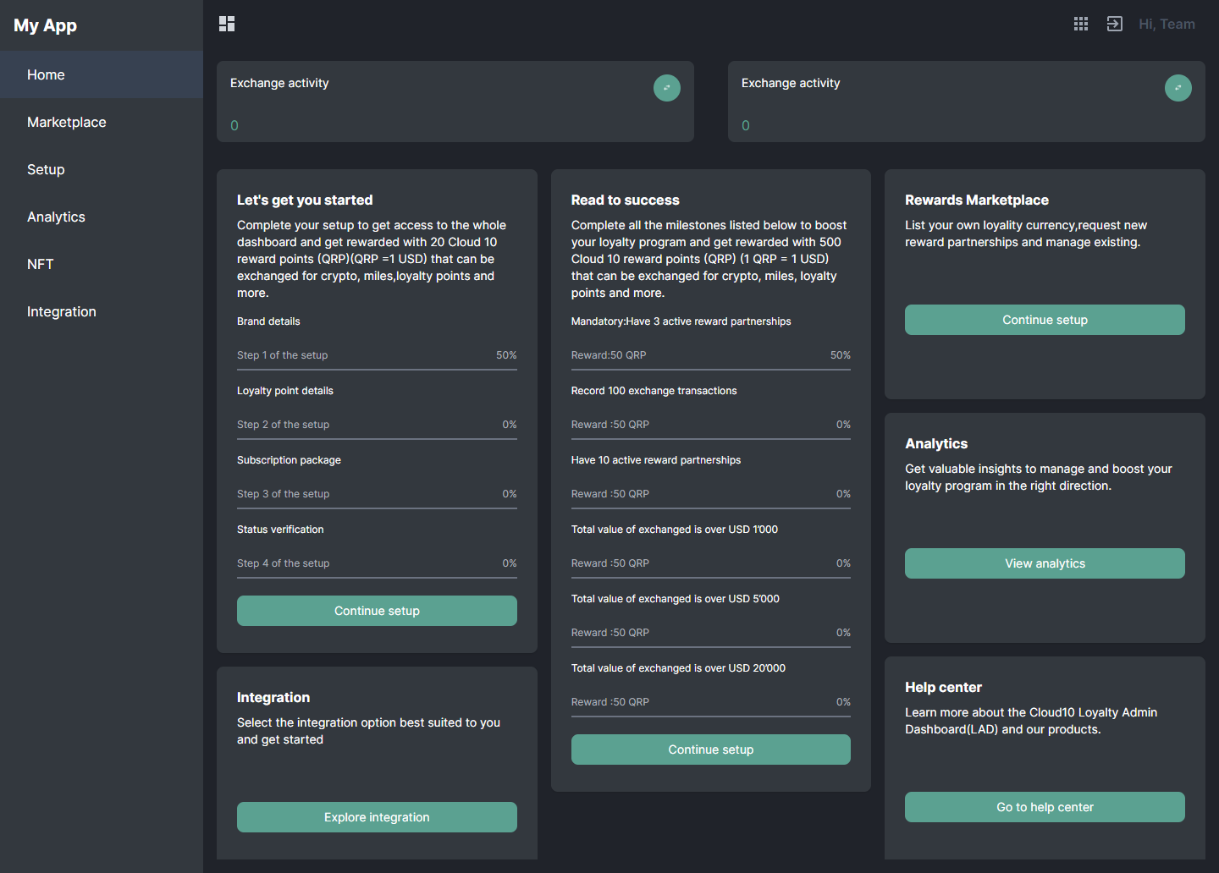
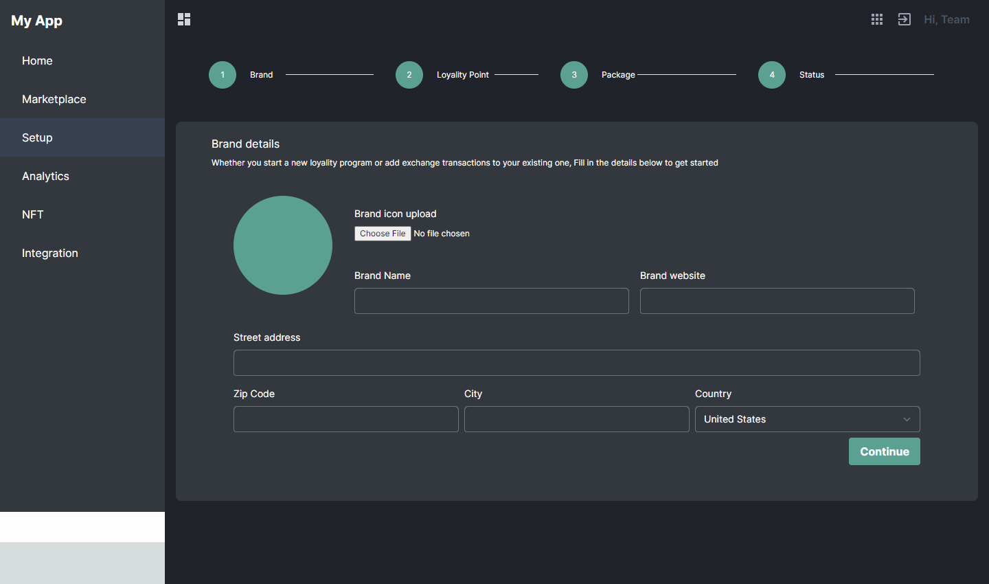
Project- Cloud1O LMS
Admin Panel UI

Slide 11
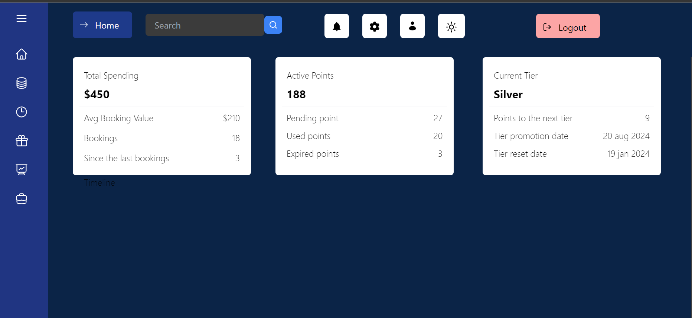
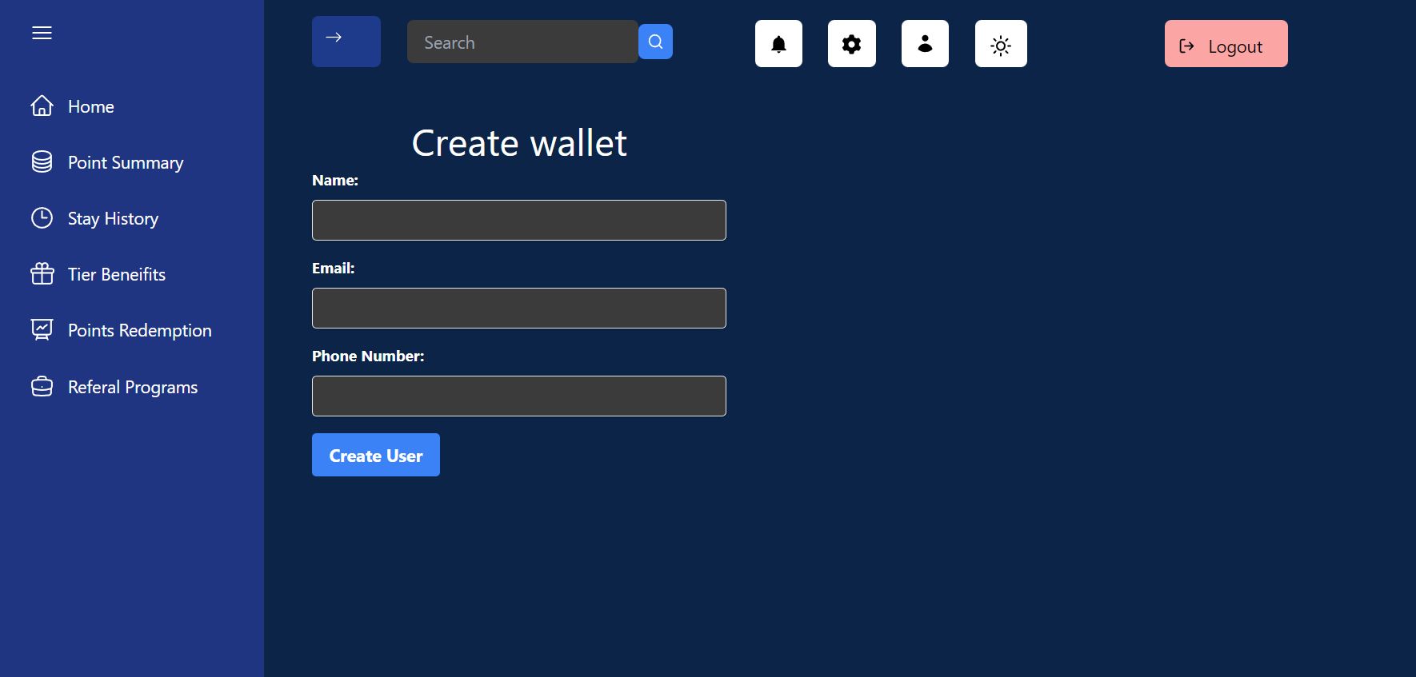
Project- Cloud1O LMS
User Panel UI

Slide 12
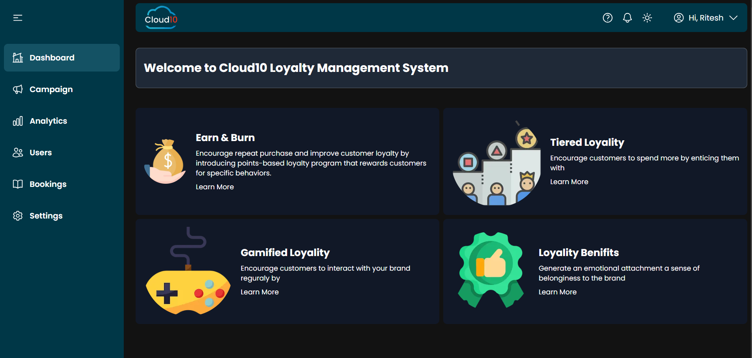
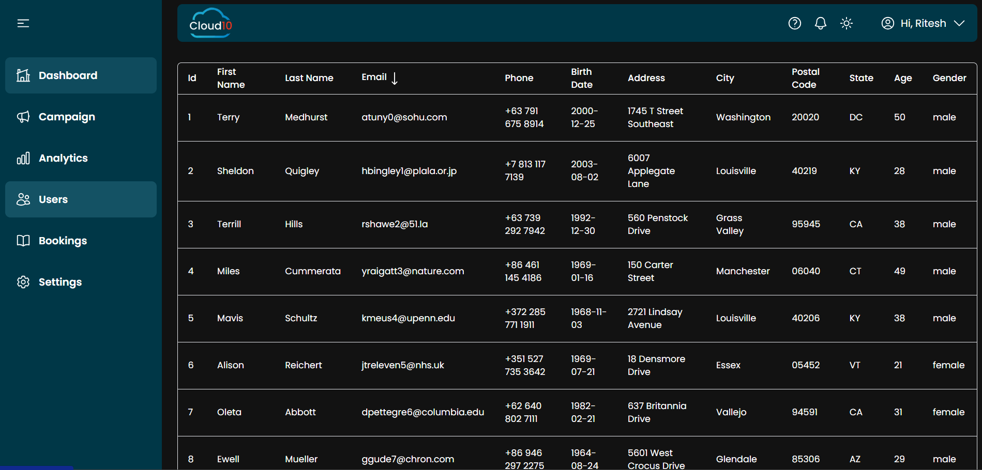
Project- Cloud1O LMS
Manager Portal UI

Slide 13
Projects
Project- Naturopura
Naturopura is an indigenous initiative and innovation to address various issues and problems faced in the Agriculture sector in India. Starting from Farmer suicide cause to an organized transparent non-aggregator based Marketplace for farmers and Consumers.
Naturopura will act as a Distributed Autonomous Organization backed by Emerging Blockchain Technology.
It will act as a transparent bridge between various govt agencies, farmers, and consumers without the interaction of a middleman.
It will give access and aware the farmers of various govt policies. In the meantime, it will also manage subsidies and govt loans in Farmer’s portfolio.
The system works along with the natural biodiversity of each farmed area, encouraging the complexity of living organisms—both plant and animal—that shape each particular ecosystem to thrive along with food plants.
Natural farming is related to fertility farming, organic farming, and biodynamic agriculture will be given priority.

Slide 14
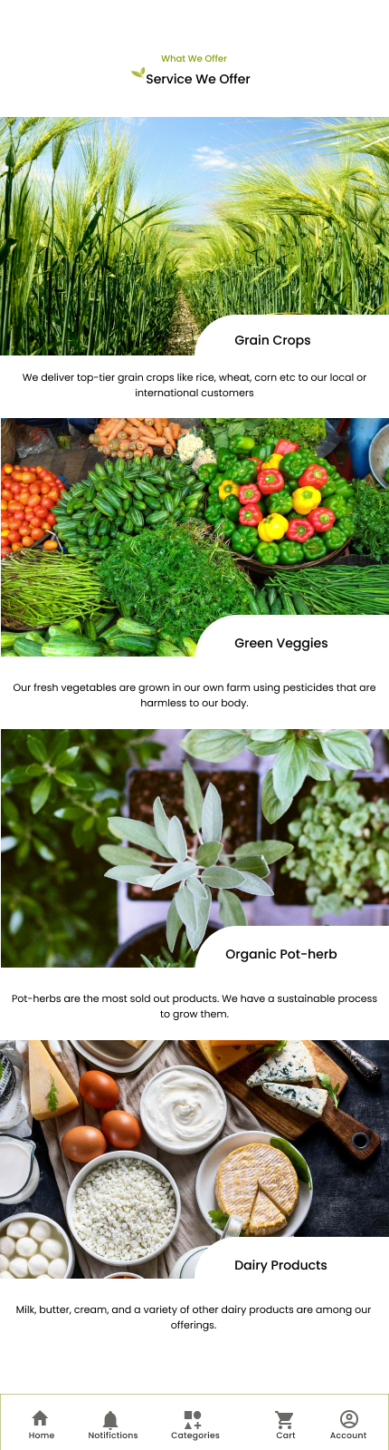
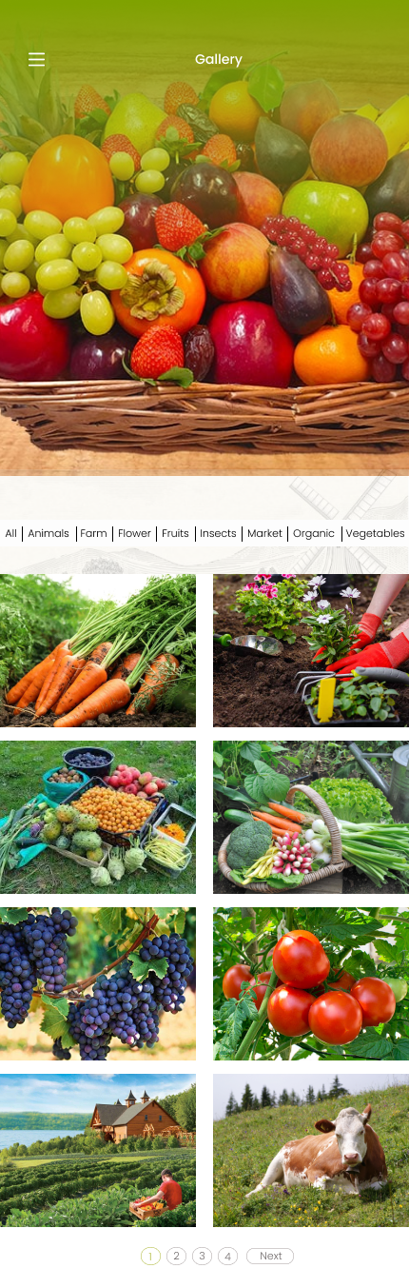
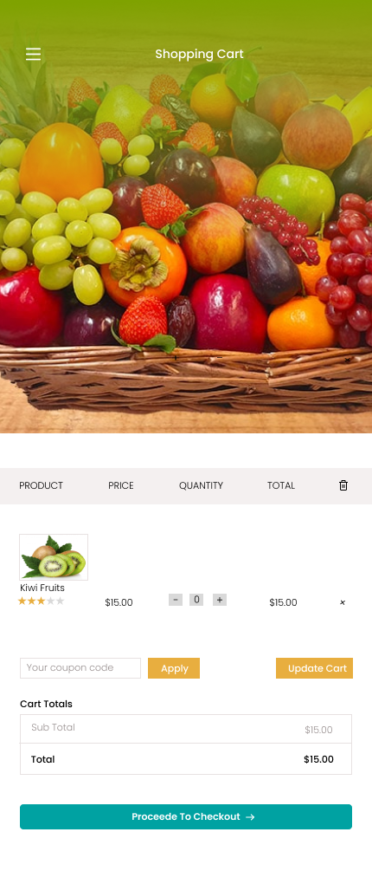
Project- Naturopura

